Slide 1
Tracing Objects and Local Variables
3.4-3.6

Slide 2
Encapsulation
Encapsulation is the process of hiding implementation details and providing methods for data access.
To encapsulate data:
Declare instance variables as private and Declare public methods that access the variables
Encapsulation allows a programmer to use a class without having to know its implementation.
Information hiding makes it simpler for the implementor of a class to locate errors and change implementations.

Slide 3
Self Check 3.1
Supply the body of a method public void unclick() that undoes an unwanted button click.
public void unclick()
{
count = count - 1;
}

Slide 4
Problem Solving: Tracing Objects
Important skill: the ability to simulate the actions of a program with pencil and paper.
On Paper track each object:
Create a block to represent each instance
Have a space to represent each instance variable within
CashRegister class
Methods: recordPurchase, recievePayment, giveChange
Instance variables: purchase and payment

Slide 5
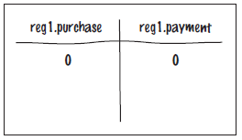
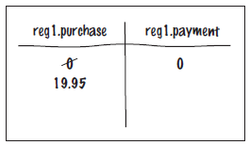
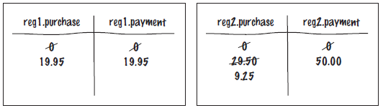
Problem Solving: Tracing Objects
When an object is constructed, fill in the initial values of the instance variables.
Update the values of the instance variables when a mutator method is called.
After a call to cashRegister's recordPurchase method
More than one object: create blocks

Slide 6
toString Method
Can be called like any other method
Is automatically called when an object variable is within a print or println method.
Provides a string representation of an object
Returns a string

Slide 7
Create a BankAccount class
Include the following:
Fields: name Stores the name of the account holder
accNum Stores the account number
balance Stores the account balance
Constructors:
-- takes two parameters to initialize the name and account number
and initializes balance to 0
-- takes three parameters to initialize all three fields
Methods:
deposit --takes a parameter for the amount to deposit and
increments balance appropriately
withdraw --takes a parameter for the amount to withdraw and
decrements balance appropriately
getBalance -- takes no parameters and returns the balance
toString -- takes no parameters and returns the value of each field

